Slide 1
Lorenz System Image Encryption
Christian Ortiz
Nick Wade
16 Aug 2022

Slide 2
Presentation Outline
State Goals
Image Encryption Definition
Lorenz System Review
Image Encryption Method outline
Results and observations
Conclusion
Scope for improvements
References

Slide 3
Goals
We will demonstrate how to accomplish an image encryption algorithm.
Utilize the Lorenz equations.
Show the utility of a subject learned in this class for a real-world application.

Slide 4
Image Encryption Definition
We consider an image encryption algorithm to be any method of transforming the values of the pixels comprising an image in a way that produces a drastically different image and is only decipherable by the sender and receiver.[1-8]
Image deconstruction vs reconstruction.
Private, secure, and selectively accessible.

Slide 5
Why Use the Lorenz Equations?
Ease of use for any image format
Size
Color
Output based on input parameters
key generation
Pseudo Random numbers
From Chaotic Behavior

Slide 6
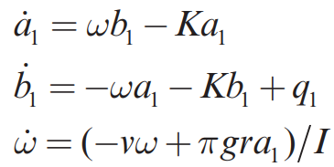
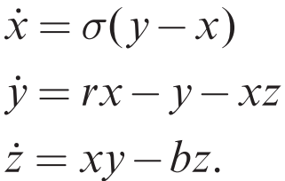
Chaotic systems create Pseudo Random numbers
Chaotic Waterwheel
[7]
Lorenz equation
[7]

Slide 7
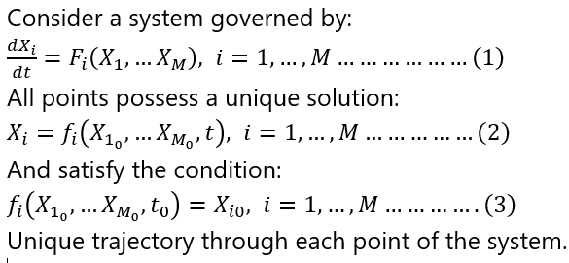
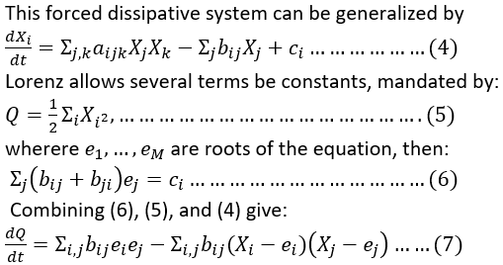
Lorenz Equation History
Finite system of deterministic ordinary nonlinear differential equations representing forced dissipative hydrodynamic flow.[11]
This derivation summary is from Lorenz's 1962 paper on Deterministic Nonperiodic Flow[11]:

Slide 8
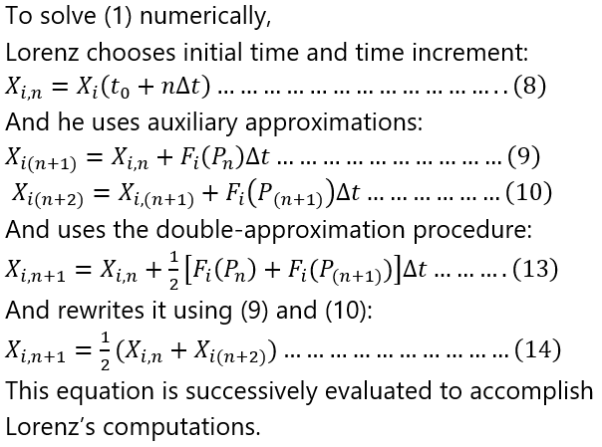
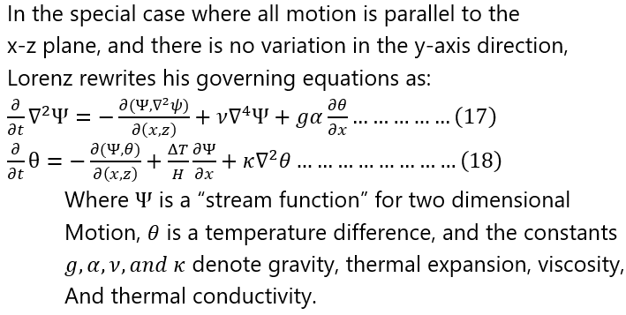
Lorenz Derivation continued

Slide 9
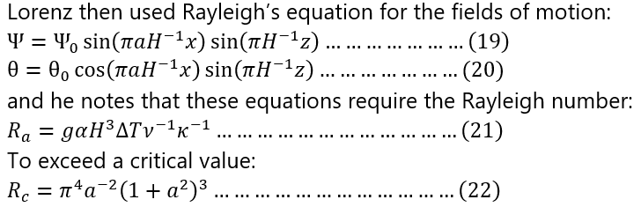
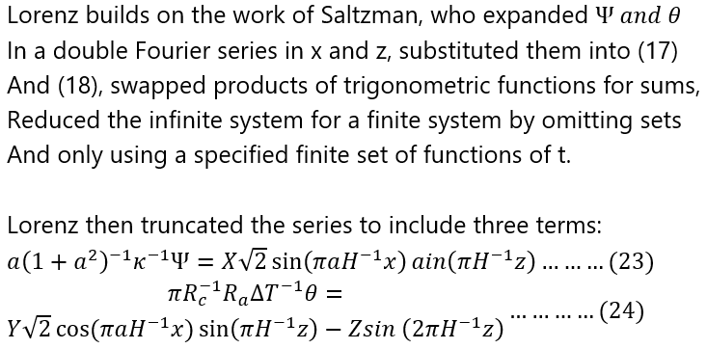
Lorenz Derivation continued

Slide 10
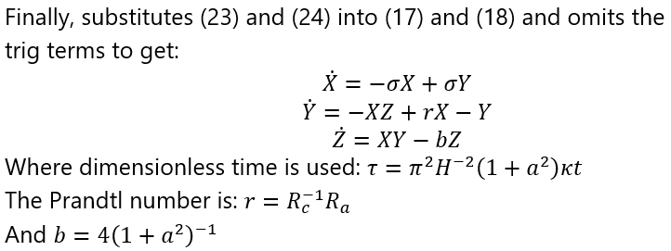
The Lorenz Equations
x is proportional to the intensity of the convective motion[15]
y is proportional to the temperature difference between the ascending and descending currents.[15]
similar signs of x and y denoting that warm fluid is rising, and cold fluid is descending. [15]
The variable z is proportional to the distortion of the vertical temperature profile from linearity. [15]
A positive value indicating that the strongest gradients occur near the boundaries.[15]

Slide 11
Uses for Lorenz Equations
Demonstrate unpredictability of weather patterns[7]
Physics, biology, complex networks, economics[1]
Generators, chemical reactions, brushless DC motors, forward osmosis, lasers, electrical circuits and passive heat exchange[4]
Cryptography and encryption[1-8]

Slide 12
Chaotic Behavior
Aperiodic long-term behavior in a deterministic system that exhibits sensitive dependence on initial conditions.[7]
trajectories which do not settle down
Sensitive dependence on initial conditions
Deterministic
Essential for decryption

Slide 13
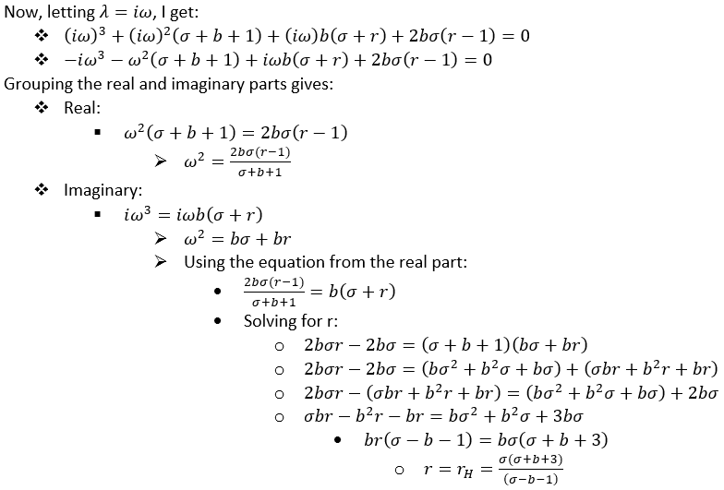
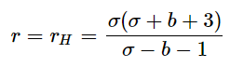
When Does Chaotic Behavior Occur?
Just after the Hopf Bifurcation.
Where does the Bifurcation Occur?
When
From problem 9.2.1 the characteristic equation for the fixed points C+ and C-:
λ3+λ2(σ+b+1)+λb(σ+r)+2bσ(r−1)=0
Hopf Bifurcation occurs when λ crosses imaginary axis.
r is the Rayleigh number or bifurcation parameter.

Slide 14
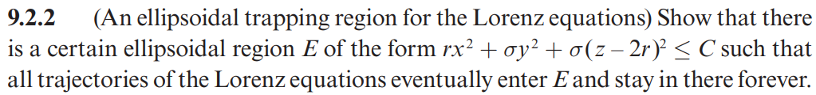
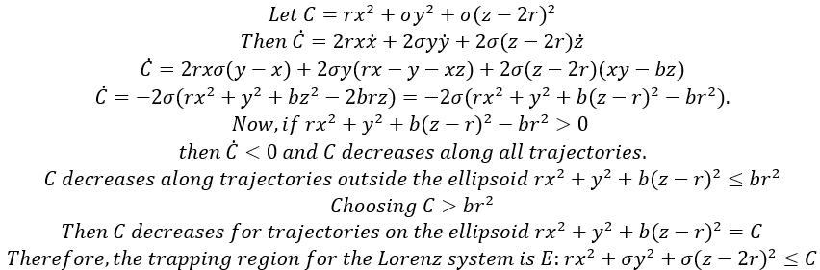
Exercise 9.2.2- bounded behavior

Slide 15
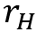
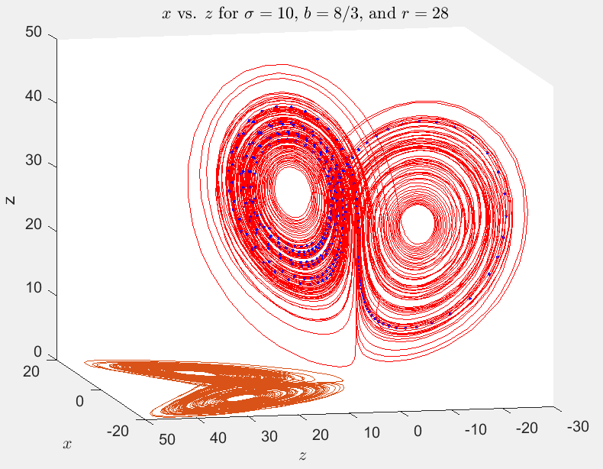
Behavior of the Lorenz system for r >
Bounded movement between unstable limit cycles and "distant attractor"
"An amazingly complicated invariant set."[7]
"Trajectories are confined to a bounded set of zero volume... they manage to move on this set forever without intersecting themselves or others"[7]

Slide 16
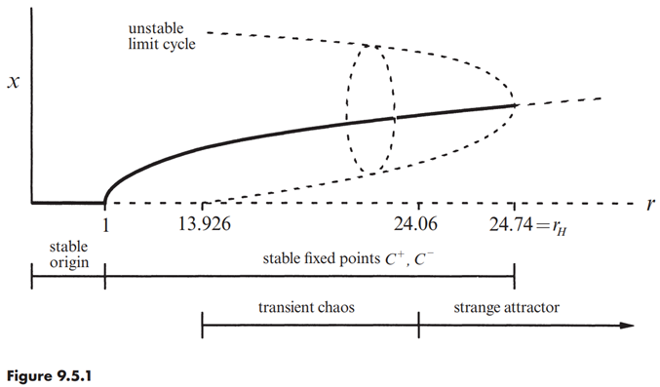
Behavior as "r" varies
r=13.926
homoclinic bifurcation
unstable limit cycles
r=24.06
infinite wander time
strange attractor.
r=24.74
subcritical Hopf bifurcation

Slide 17
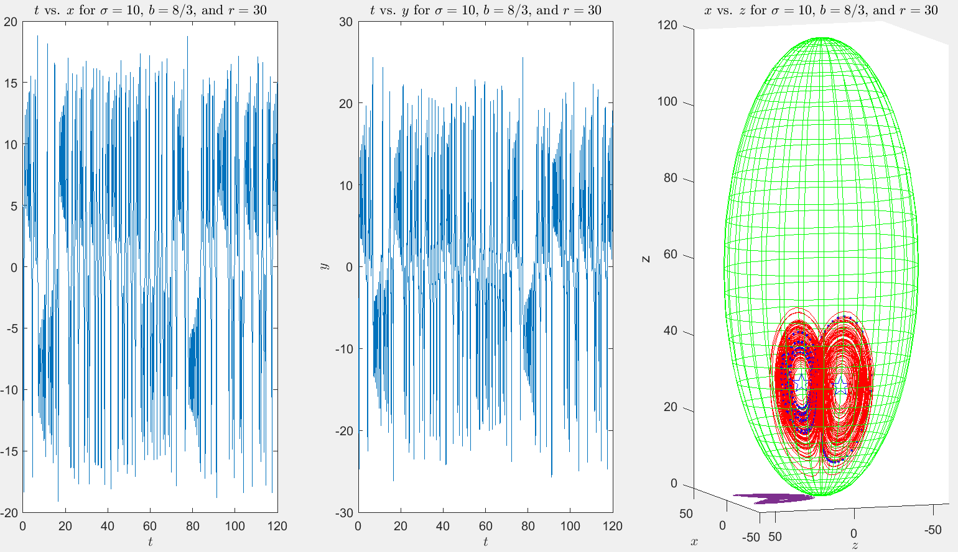
Our Parameters: r=30, 𝜎=10, b=8/3

Slide 18
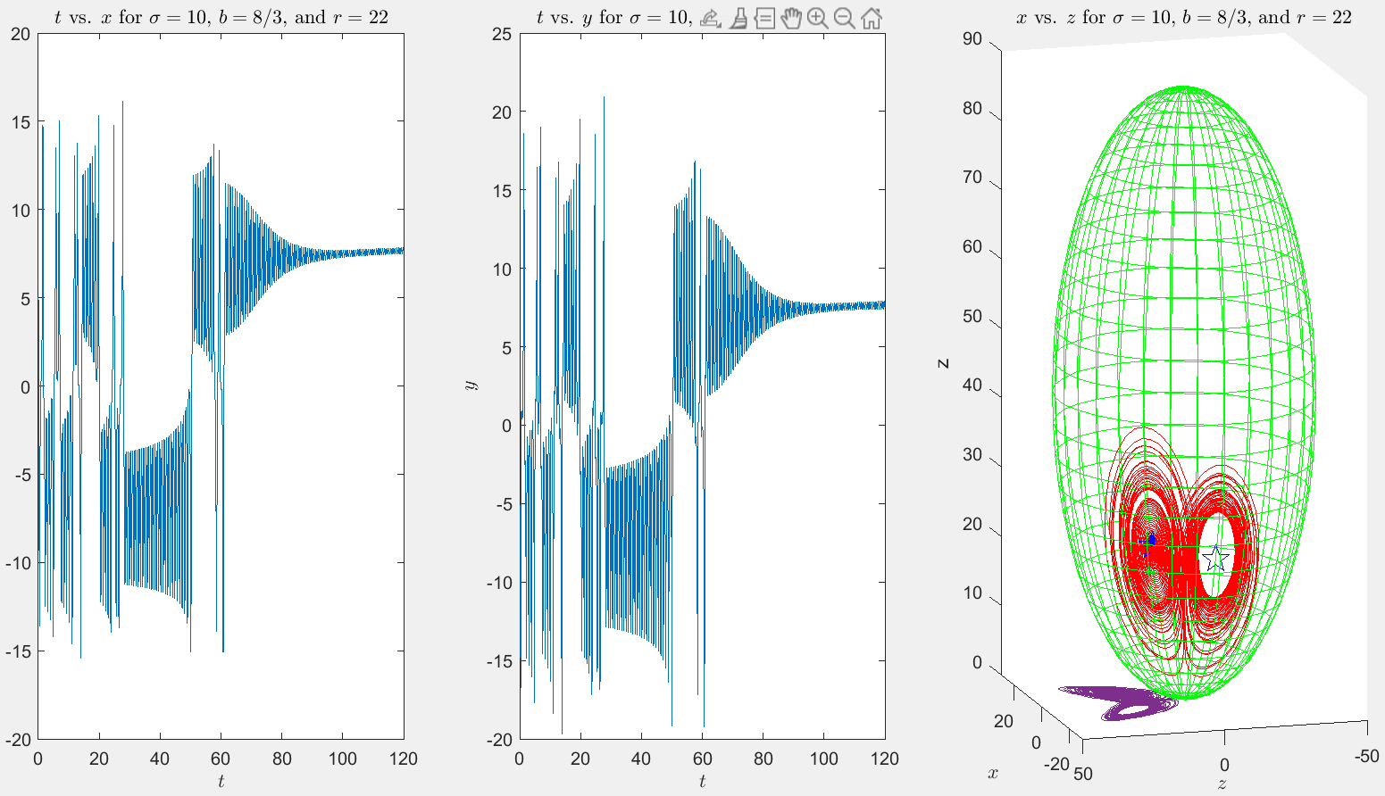
Our parameters: r=22, 𝜎=10, b=8/3

Slide 19
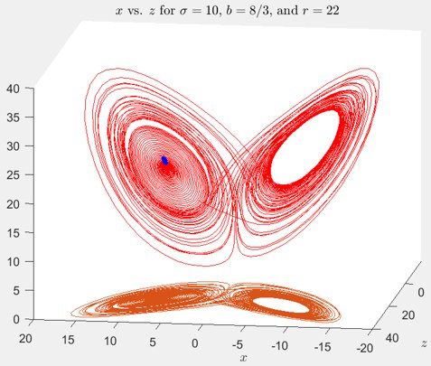
Transient Chaos
"Transient chaos shows that a deterministic system can be unpredictable, even if its final states are very simple. In particular, you don’t need strange attractors to generate effectively random behavior."[7](Strogatz 340)

Slide 20
Summary of Desirable Lorenz System Characteristics
Ease of use.
Receiver has access to Lorenz system and key.
Easy to transform pixel values based on generated pseudorandom numbers.
Output based on input parameters
Facilitates key generation from parameters and initial conditions.
Pseudo Random numbers
From Chaotic Behavior
Prevents "hacking" via Fourier decomposition and other statistical methods.

Slide 21
Encryption Methods
Separate functions were created for the encryption and decryption of the image but utilize same principle.
Both methods rely on Lorenz equations.
Solve for x/y/z trajectories based on initial x, y, z and system parameters.
From these, create a set of pseudorandom numbers [12]
Correlate pseudorandom numbers with pixel RGB values using XOR op

Slide 22
Encryption algorithm steps:
Given initial conditions x0, y0, z0, Lorenz parameters sigma, r, b, and an NxM image to encrypt.
Produce PRNs at least N*M datapoints of x/y/z over the desired t-space. [12]
Create x, y, z values from Lorenz equations w/ initial conditions and parameters over desired t-space.
Multiply each x, y, and z value by 10^13 and convert to IEEE754 floating point.
The last 8 bits to step 1b is the PRN. This is achieved using step1b mod 256. Result is stored as [Xc, Yc, Zc]
Pixel [R, G, B] XOR Step 1 result [Xc, Yc, Zc]
Resplice image pixels together. The order in which this is achieved is user preference.
Note: In testing, "t-space" was 0 to 20 in 300*300=90,000 steps. However, further simplification can be utilized by setting the end time to the absolute value of the product of the Lorenz parameters (|sigma*r*b|) and the number of steps to the number of pixels (N*M)
Note 2: Decryption is the same algorithm, just applied against the encrypted image

Slide 23
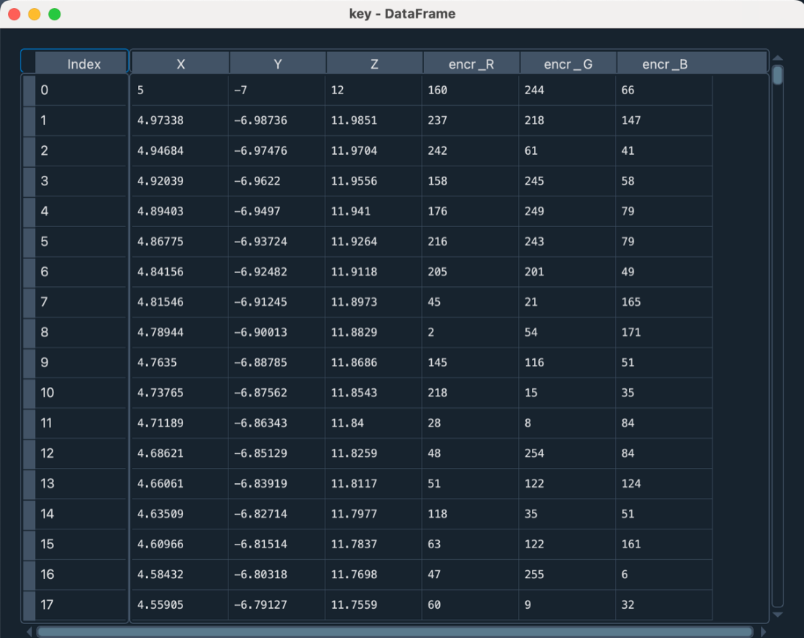
Generated random numbers

Slide 24
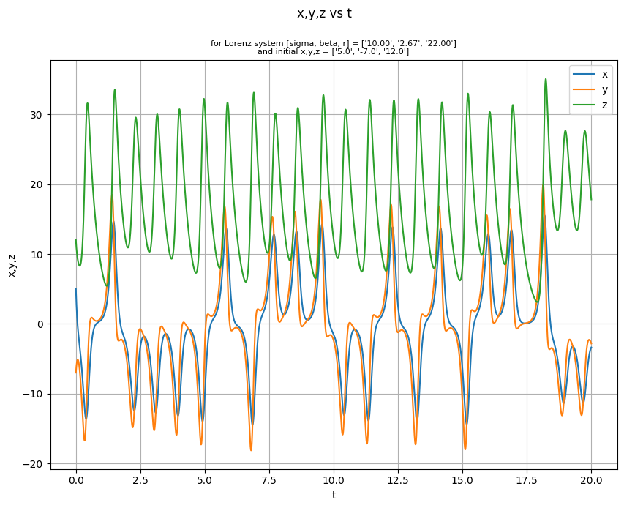
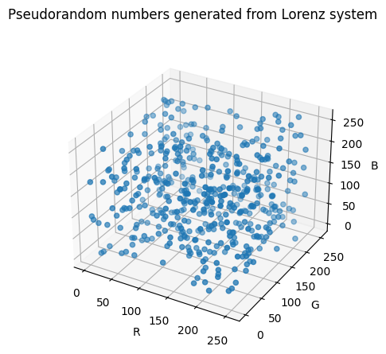
Results: step 1 Pseudorandom Number Generation

Slide 25
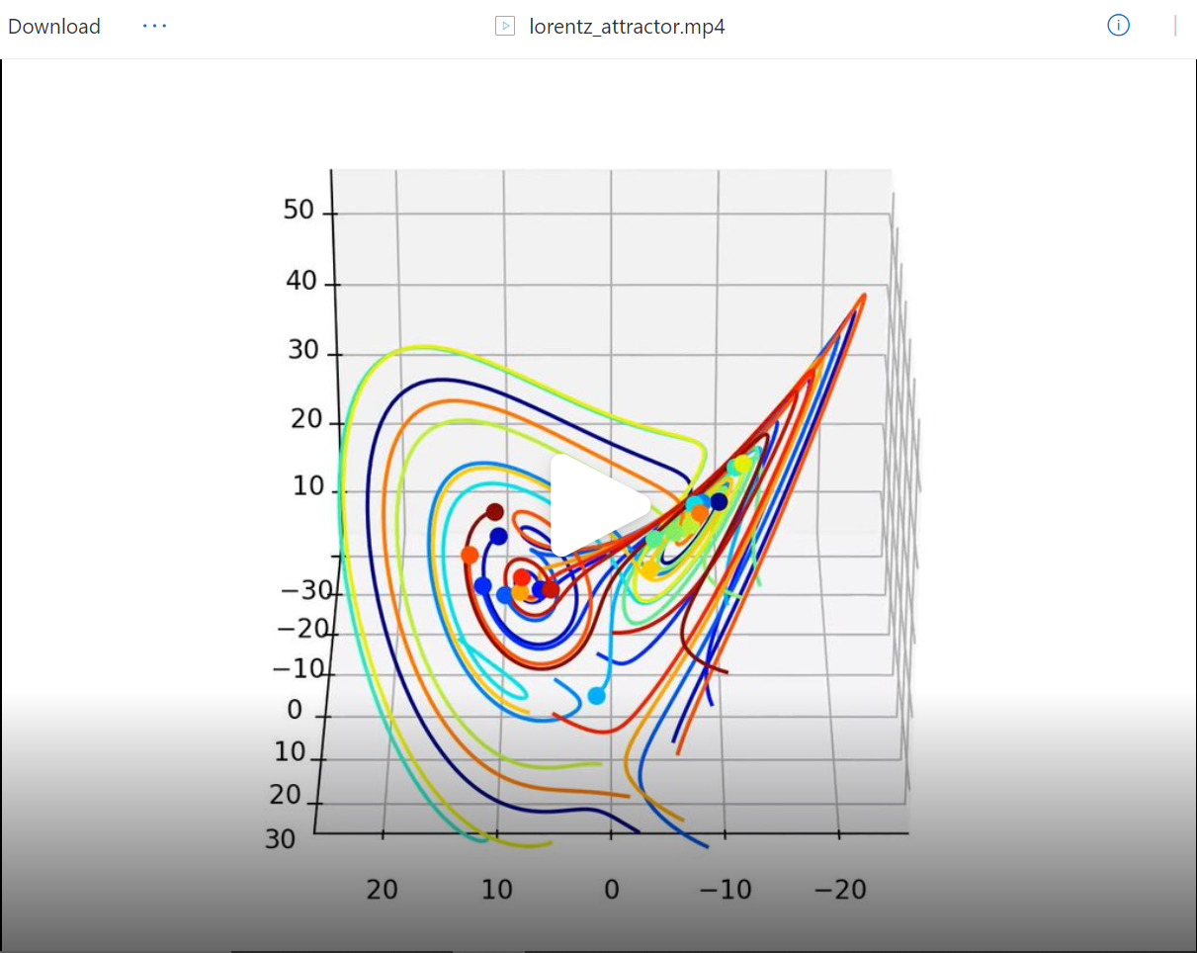
Lorenz Attractor Video

Slide 26
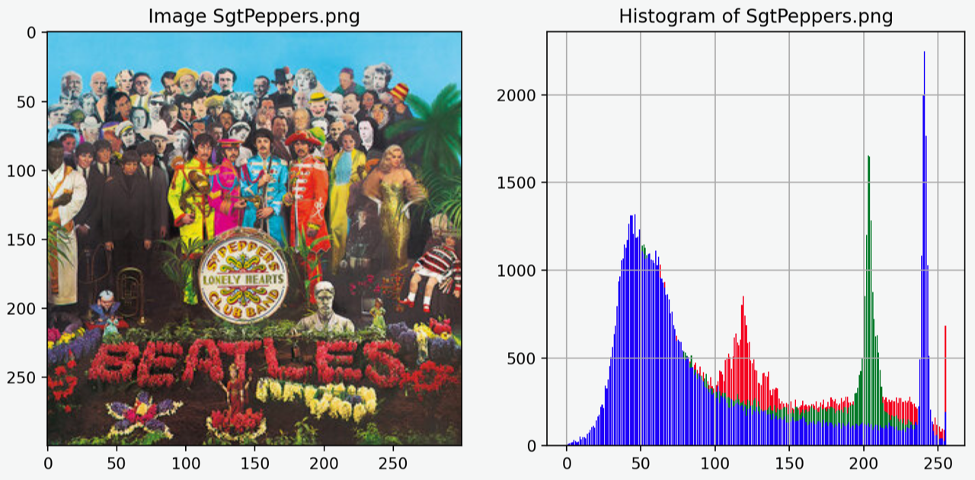
Results: Original Image

Slide 27
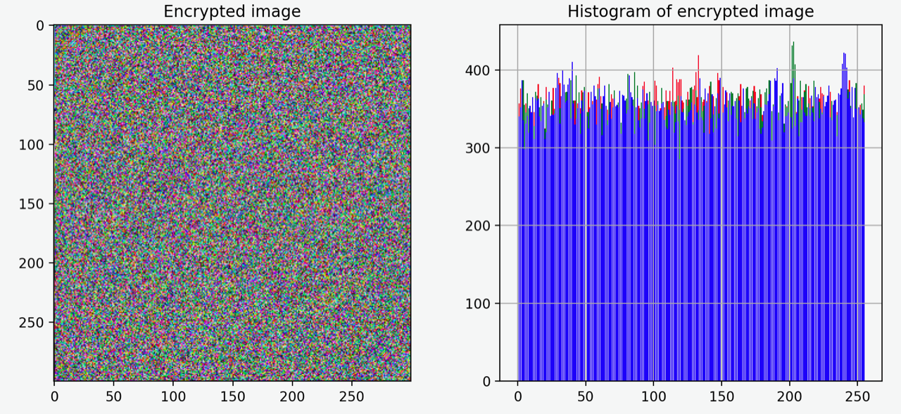
Results: Encrypted Image

Slide 28
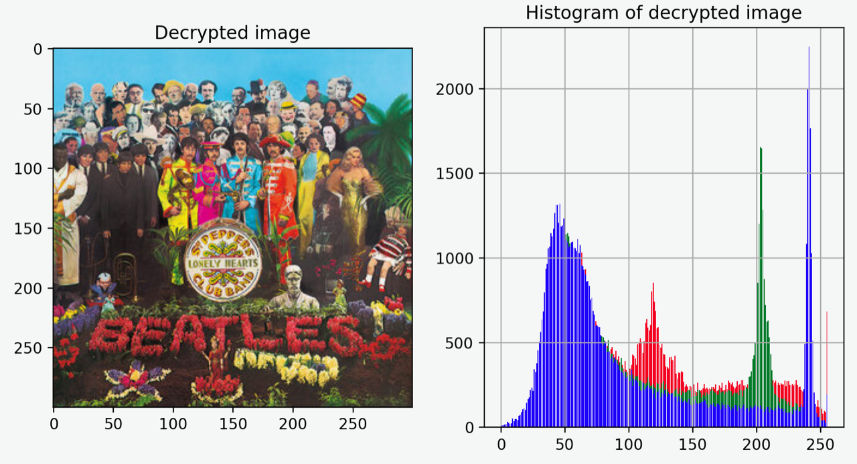
Results: Decrypted Image

Slide 29
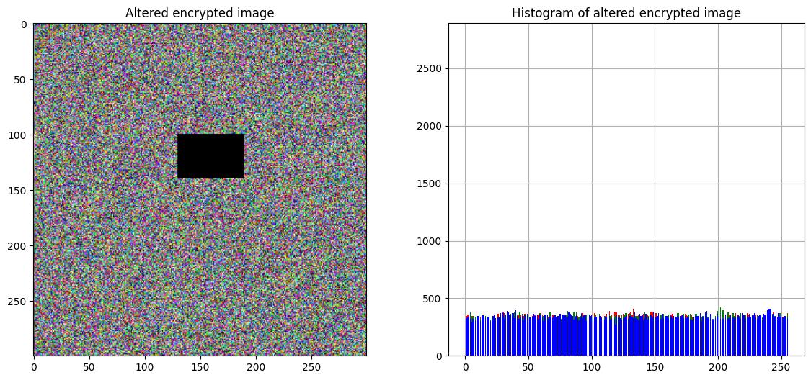
Results: Added noise

Slide 30
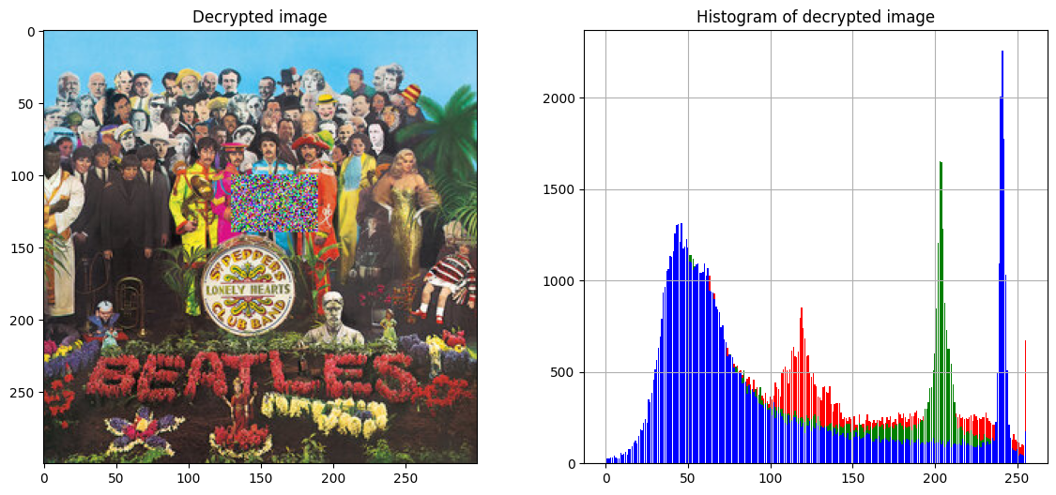
Results: Added noise

Slide 31
Results: Time Analysis on a 2.3 GHz i5 processor Macbook Pro with 8 GB of memory
Function | Description | Elapsed Time (sec)
Load Lorenz Trajectories (N=300*300) | Solve Lorenz system w/ specific initial conditions and parameters and calculate cipher values (PRNs) | 15.678
Read Image | Read saved .png file into numpy arrays (encrypted & decrypted) | 0.713
Encrypt Image | Encrypt image based on PRNs and pixel RGB | 13.845
Decrypt Image | Decrypt image based on PRNs and pixel RGB | 14.021
Function | Elapsed Time (sec) | Increase from 300x300 image processing time*
Load Lorenz Trajectories (N=1920*1080) | 310.218 | +1978.7%
Read Image | 2.681 | +376.0%
Encrypt Image | 284.824 | +2057.2%
Decrypt Image | 291.122 | +2076.3%
Total | 888.845 | +2008.4%
300x300 Image test
1920x1080 Image test
*image has x20 more pixels

Slide 32
Conclusion
We find the Lorenz equations to be an effective tool for accomplishing Image Encryption.
Pseudorandom numbers can be injected into a simple encryption algorithm to encrypt image data sufficiently albeit slowly.
The concise equations afford lower code complexity while the disorganized algorithm is likely to blame for most efficiency bottlenecks.
Lorenz Equations provide sufficient chaotic behavior to employ adequate encryption techniques

Slide 33
Scope for improvements
Higher levels of security are accomplished by adding layers of encryption.
To improve this project, the key could be encrypted. [6][8]
Asymmetric encryption
End-to-end encryption
Public and private key
Several papers have suggested using some form of "improved Lorenz system"[1][2][3][4]
Pixel permutation of rows and columns
Varying parameters

Slide 34
References
Zou, C., Zhang, Q., Wei, X., & Liu, C. (2020). Image encryption based on improved Lorenz system. IEEE Access, 8, 75728-75740.
https://ieeexplore.ieee.org/stamp/stamp.jsp?arnumber=9072440
Kaur, M., & Kumar, V. J. E. L. (2018). Efficient image encryption method based on improved Lorenz chaotic system. Electronics Letters, 54(9), 562-564.
https://ietresearch.onlinelibrary.wiley.com/doi/epdf/10.1049/el.2017.4426
Huang, L., Shi, D., & Gao, J. (2016). The design and its application in secure communication and image encryption of a new Lorenz-like system with varying parameter. Mathematical Problems in Engineering, 2016.
https://downloads.hindawi.com/journals/mpe/2016/8973583.pdf
Arshad, U., Batool, S. I., & Amin, M. (2019). A novel image encryption scheme based on Walsh compressed quantum spinning chaotic Lorenz system. International Journal of Theoretical Physics, 58(10), 3565-3588.

Slide 35
References cont.
5. Peng, X., & Zeng, Y. (2020). Image encryption application in a system for compounding self-excited and hidden attractors. Chaos, Solitons & Fractals, 139, 110044.
https://www.sciencedirect.com/science/article/pii/S0960077920304410
6. Narasimhan Aarthie and Rengarajan Amirtharajan, 2014. Image Encryption: An Information Security Perceptive. Journal of Artificial Intelligence, 7: 123-135.
https://scialert.net/fulltext/?doi=jai.2014.123.135
7. Strogatz, S. H. (2018). Nonlinear dynamics and chaos: with applications to physics, biology, chemistry, and engineering. CRC press.

Slide 36
References cont.
8. Pandya, D., Ram, K., Thakkar, S., Madhekar, T., & Thakare, B. (2015). Brief History of Encryption. International Journal of Computer Applications, 131(9), 28-31.
https://citeseerx.ist.psu.edu/viewdoc/download?doi=10.1.1.741.6752&rep=rep1&type=pdf
9. Lyon, R. F. (2006, February). A brief history of 'pixel'. In Digital Photography II (Vol. 6069, p. 606901). SPIE.
http://www.dicklyon.com/tech/Photography/Pixel-SPIE06-Lyon.pdf
10. Smith, A. R. (1995). A Pixel Is Not A Little Square, A Pixel Is Not A Little Square, A Pixel Is Not A Little Square!. Microsoft Computer Graphics, Technical Memo, 6.
http://alvyray.com/Memos/CG/Microsoft/6_pixel.pdf

Slide 37
References cont.
11. Lorenz, E. (1962). Deterministic Nonperiodic Flow. Journal of Atmospheric Sciences. Volume 20 Issue 2, pages 130-141.
12. Lynnyk, V., et al (2015). Pseudo random number generator based on the generalized Lorenz chaotic system, 4th IFAC Conference on Analysis and Control of Chaotic Systems CHAOS 2015. Volume 48, Issue 18, pages 257-261.
13. McGuinness, P. (2022, January 26). The Beatles album covers explained. uDiscover Music. Retrieved August 14, 2022, from
https://www.udiscovermusic.com/stories/the-beatles-album-covers-explained/
15. Marsden, J. E., & McCracken, M. (2012). The Hopf bifurcation and its applications (Vol. 19). Springer Science & Business Media.

Slide 38
Additional slides:

Slide 39
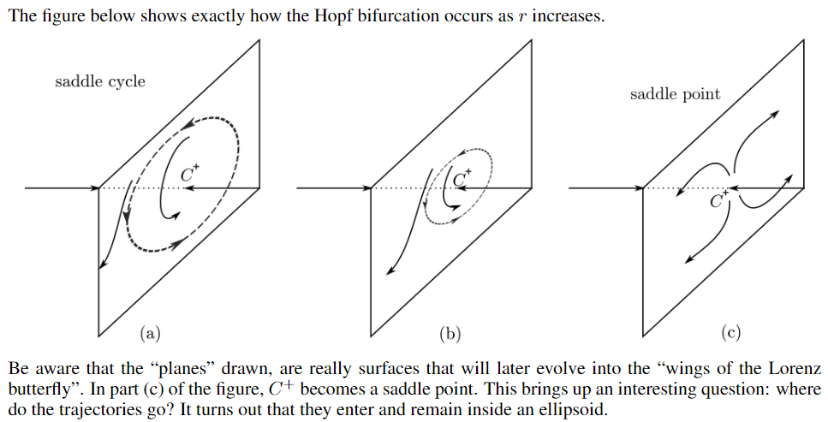
Lecture 10, Hopf Bifurcation

Slide 40
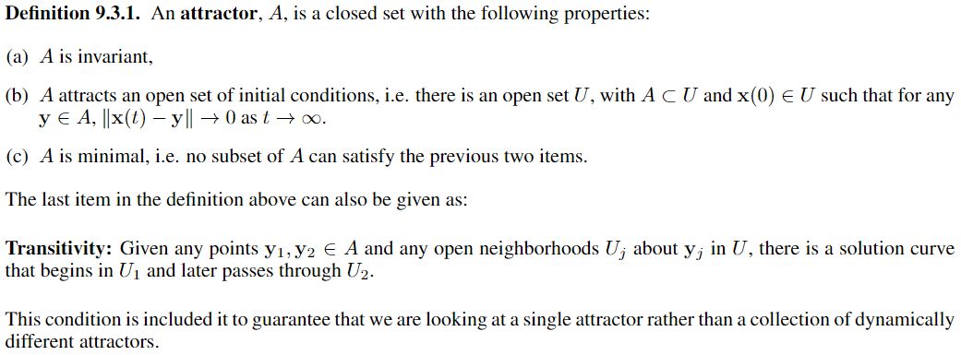
Lecture 10: Attractor Definition:

Slide 41
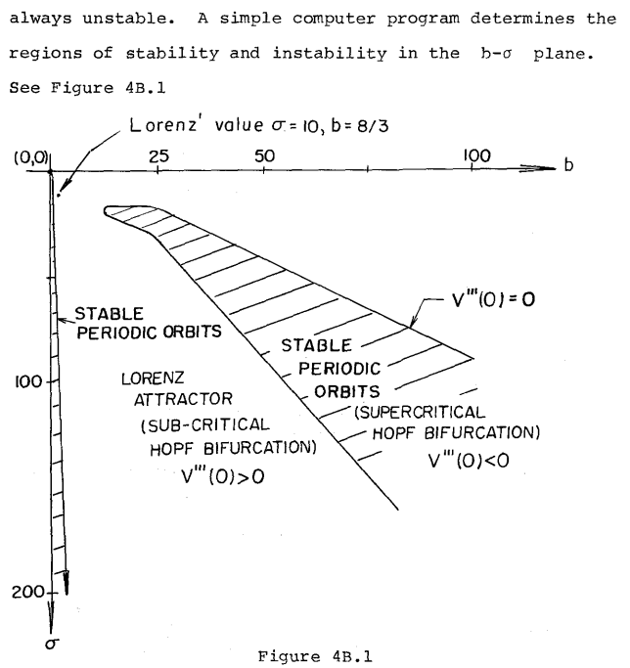
𝜎= K^(-1)*\nu is the Prandtl number, where K is the coefficient of thermal expansion and v is the viscosity;
r, the Rayleigh number, is the bifurcation parameter.

